Slide 1
Do you use Selenium Only for Test Automation
SeConf 2023, Chicago.
Notes:
Credits to organizers and the Selenium Project for getting us here and for the lovely conference. With that positive note, lets dive in .

Slide 2
About me
AVP-Engineering and Innovation @Provar
M.O.M (Manager of managers) at office
Mentor at Plato & ADPList
Maker at testzeus.com
Instructor at TAU.
https://www.linkedin.com/in/polymorphicrobin/
@smilinrobin
Notes:
Go slow here
Talk a bit about Provar
Talk about Test Zeus

Slide 3
What is the main purpose of using Selenium for you?
ⓘ Start presenting to display the poll results on this slide.

Slide 4
Once upon a time, a very smart engineer (named Jason), thought of creating a software to automate the timesheets, and the rest as they say is history…
Notes:
If you want to know more about the story, catch Jason in the café or at drinks

Slide 5
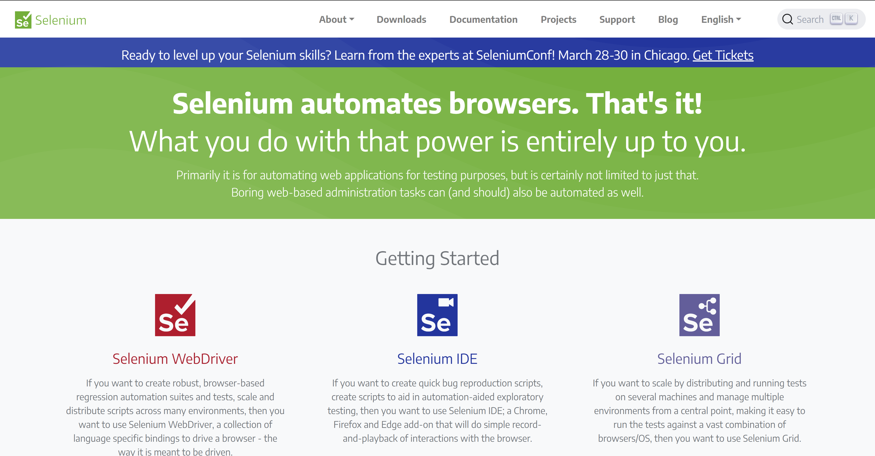
One saying to rule them all

Slide 6
1
NFT
Selenium for Non-Functional Tests

Slide 7
NFT using Selenium
Notes:
So our transaction here took 11914 MILLISECONDS. Or you can use Axe-core to automate your accessibility tests.
And if you would like to know more, we had Roger from Abstracta present a nice DSL to integrate Jmeter with Selenium yesterday.

Slide 8
Non-Testing Use Cases
Site Adminstration
SEO
Selenium can be used to automate site administration tasks such as adding or deleting users, modifying site settings, and managing content. This can save a significant amount of time for site administrators.
Search Engine Optimization (SEO) is critical for the success of any website. Selenium can be used to automate tasks such as link building, and artificial traffic, which can improve the website's search engine ranking
Web Scraping
Deals Shopping
Selenium can be used for web scraping, which is the process of extracting data from websites. This can be useful for market research, competitor analysis, and content aggregation
Selenium can be used to automate online shopping tasks such as finding deals, adding items to the cart, and checking out. This can save time and effort for online shoppers and increase their chances of finding the best deals.

Slide 9
Web Scraping
Notes:
How many people use Selenium with python? Give me a “HEY”
Imagine using this technology to fetch details from websites which don’t offer an API. Joe colantino mentioned that he used Selenium to get the number of listeners of the show using Selenium

Slide 10
Web Traffic
Notes:
We are using Selenium here to hit TestZeus, which is my opensource test automation project to automate salesforce tests.

Slide 11
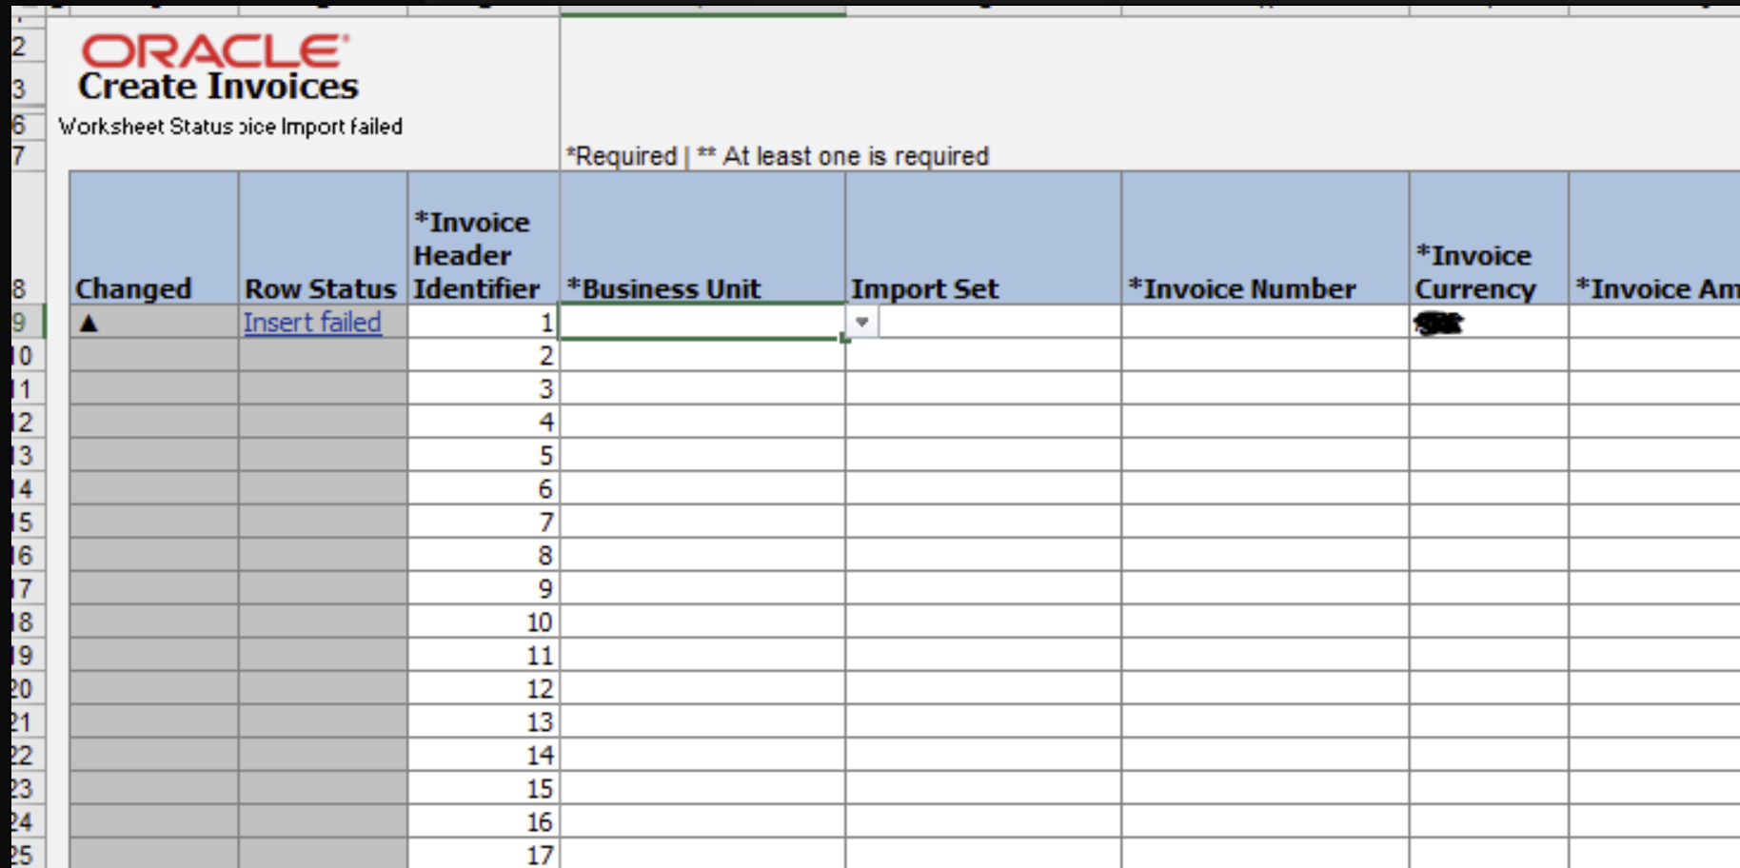
That one meeting…

Slide 12
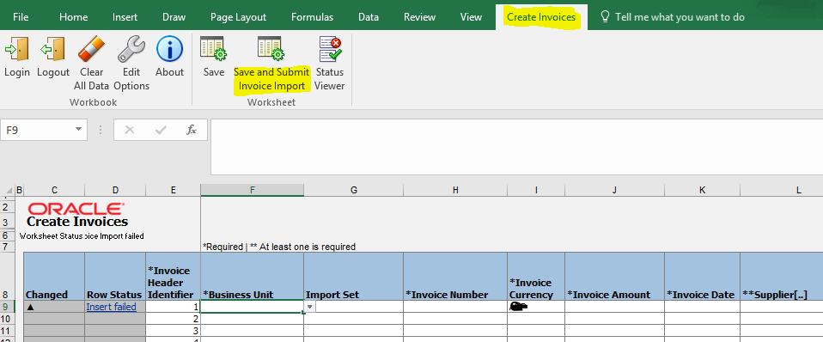
Everything Changed

Slide 13
Hello WinappDriver

Slide 14
Simple design
Preferred Language: Python, Java etc.
Preferred Environment: Visual Studio, Xcode, IntelliJ etc.
Appium Server
iOS
Android
Windows (WinappDriver)
Notes:
https://www.linkedin.com/pulse/poor-mans-rpa-robin-gupta/?trackingId=LLYvdEaNR2KlKafxF7YGwg%3D%3D
https://github.com/licanhua/YWinAppDriver

Slide 15
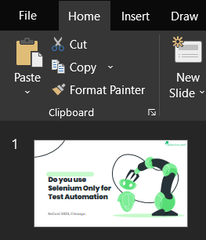
Element Identification
powerPointSession.findElementByName(“Slide Do you use Selenium Only for Test Automation").click();

Slide 16
Demo Time 1. Element identification 2. Script execution
P.S. : WinAppDriver seems to be an abandoned ship, but they have a sibling project called YWinAppDriver, which shares the same architecture and APIs.

Slide 17
Sample Use Cases
Sales
Banking
Healthcare
Invoice Development & Delivery
CRM Updating
Keeping Scorecards Up to Date
Check KYC
Underwriting
Execution of Trade
Electronic records & data sharing.
Appointment Management

Slide 18
Half empty half full
Selenium and its sibling technologies can be used to automate not just the web, but everything else on Desktop, mobile and other e-devices.
The use cases can range from test automation to full stack process automation.
We need to be mindful of server side execution.
Don’t over-fit the function and use Selenium and its siblings for everything (there are APIs).
Factor in the operating costs, maintenance and be pragmatic about the ROI.
Notes:
What is an RPA tool? It’s a collection of utilities to automate your web and desktop applications. And isn’t testing a process, so if you are writing automation code, by any standards you are already an RPA engineer.

Slide 19
"I fear not the man who has practiced 10,000 kicks once, but I fear the man who had practiced one kick 10,000 times"
This Photo by Unknown Author is licensed under CC BY-NC-ND
Notes:
Go slow here: Ive seen a lot of folks in our ecosystem, going all about various tools, without getting into the real depth of one tool or platform, So as Mr Lee said, if you polish yourself on one tool deep enough, you can be a real master in the field. And with real mastery comes infinite possibilities.

Slide 20
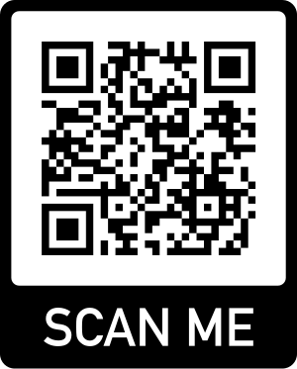
Thanks
https://www.linkedin.com/in/polymorphicrobin/
@smilinrobin

Slide 21
Appendix

Slide 22
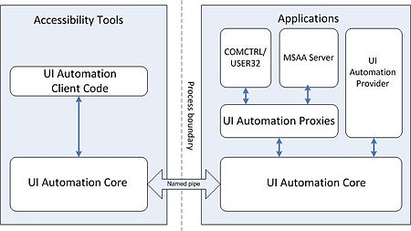
Detailed design
At client side, UIA provides a .NET interface in UIAutomationClient.dll assembly and a COM interface implemented directly in UIAutomationCore.dll.
At server side, UIAutomationCore.dll is injected into all or selected processes on the current desktop to perform data retrieval on behalf of a client.
Notes:
https://www.linkedin.com/pulse/poor-mans-rpa-robin-gupta/?trackingId=LLYvdEaNR2KlKafxF7YGwg%3D%3D
https://github.com/licanhua/YWinAppDriver

